Slide 1

Data Analytics Bootcamp –UOT Final Project - Group 7
PREDICTION OF FACTORS LEAD TO HEART DISEASE

Slide 2
CONTENTS
Overview
Objective
Data Sources
Analytical Questions
Predictive Analytics
Conclusion

Slide 3
OVERVIEW :
According to the WHO, heart diseases are the leading cause of death globally. Approximately 17.9 million people die each year from heart diseases and estimated around 32% of all deaths worldwide. There have been identified many important factors which lead to heart disease. Identifying those risk factors and motivating people to adopt and following healthy behaviours is very important.

Slide 4
OBJECTIVE:
Our team use a heart disease dataset with different factors to predict which factors are at highest risk of leading to heart disease. Our team’s target audience would be the health care professionals as they will be able to apply the most current and up to date research and evidence to patient care and helping people preventing premature deaths related to heart diseases.

Slide 5
DATA EXPLORATION

Slide 6
Data Sources & Resources
Data Source: heart_disease_key_indicators.csv
Software: Python 3.7.10, Visual Studio Code 1.38.1, Jupyter Notebook, Anaconda3, PgAdmin.
Resources: https://www.kaggle.com/datasets?search=heart+disease.

Slide 7
Import and Get to know the Data | Data Cleaning | Distributions and Relationship
Importing libraries and files for exploratory data analysis Creating data frame and checking number of columns and rows. | Checking the data types. Checking the data characters mistakes. Checking the null values. Checking and removing the duplicates. Transforming the target variable. | Loading data by Postgres Target variable visualization Other variable against target variable visualizations. Correlation Visualization.

Slide 8
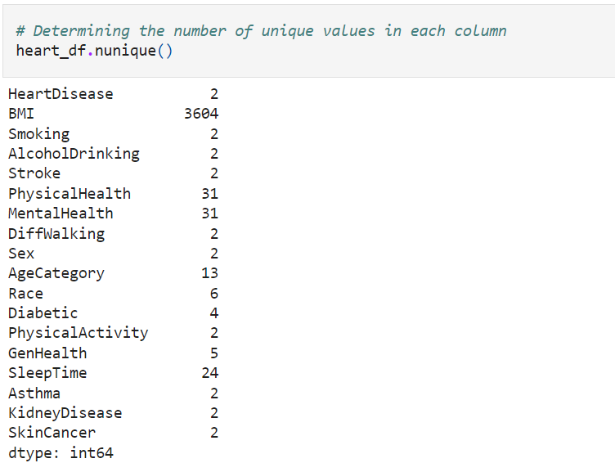
The variables types are
Binary – HeartDisease (target),Smoking,
AlcoholDrinking, Stroke, Diffwalking,
Sex, PhysicalActivity, Asthma,
KidneyDisease, SkinCancer
Categorical – Race, Diabetic,
GenHealth
Continuous – BMI, PhysicalHealth ,
MentalHealth , Age Category, Sleeptime

Slide 9
DATA STORAGE

Slide 10
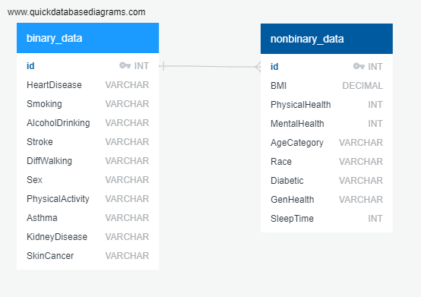
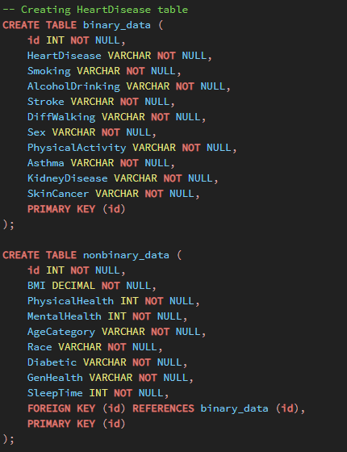

Slide 11
PRELIMINARY ANALYSIS

Slide 12

Analytical Questions
What are the key indicators that lead to heart disease ?
What factors had the greatest influence on a person developing heart disease and in what proportions ?
Can a machine learning model accurately predict whether a person will develop heart disease based on the data provided ?

Slide 13
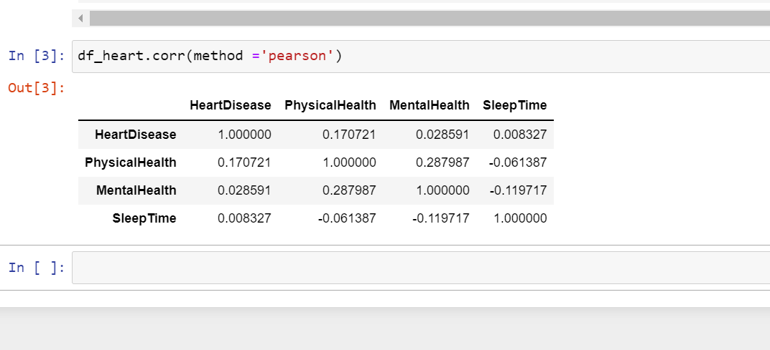
Correlation among the columns

Slide 14
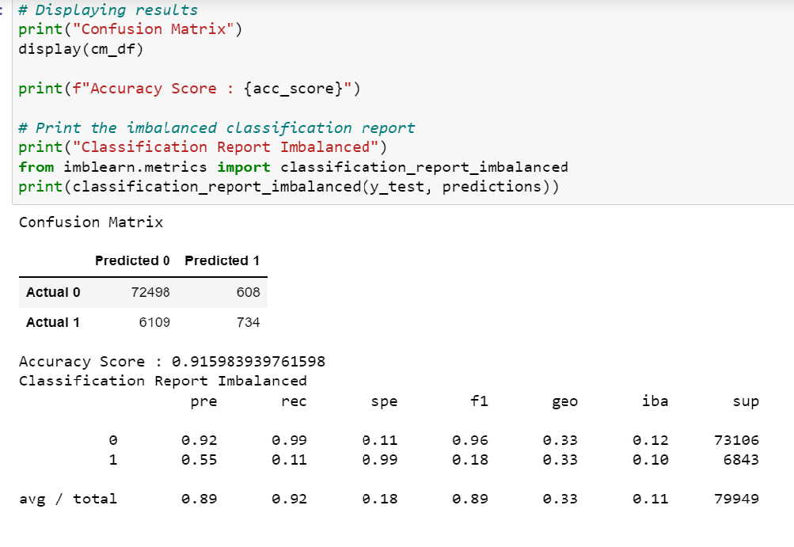
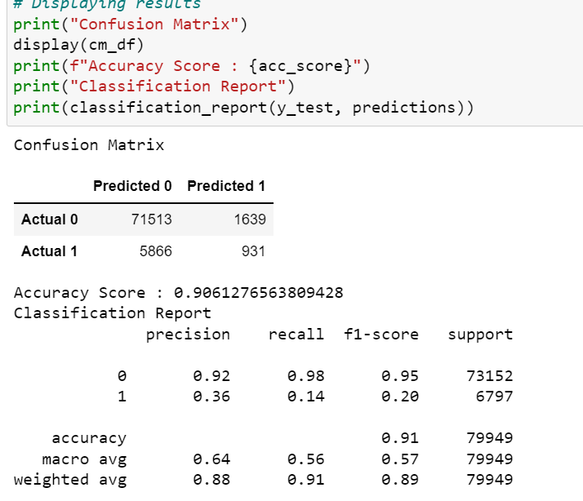
Logistic Regression and Random Forest Classification

Slide 15
DASHBOARD

Slide 16
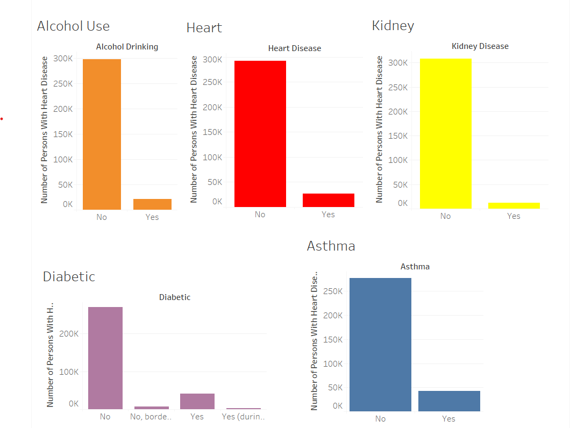
Conclusion
Findings
Tableau Storyboard - https://public.tableau.com/app/profile/ethan.mcbride/viz/HeartDiseaseKeyIndicatorsDashboard/GeneralOverview

Slide 17








The Team
Ethan McBride
Andres Pombo
Sergei Zhukov
Marian Salgadoe
Thank you

